Slide 1
PEST Trial and Errors
Andy Banks
April 2019

Slide 2
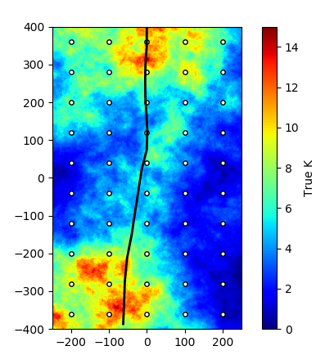
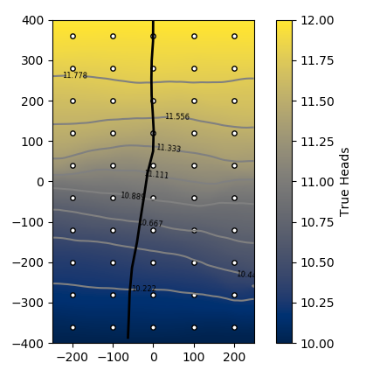
Truth
Used fft to generate correlated Gaussian random K field
alpha ~3
K range [0.01,15]
Mean = 7
Constant head
(12m) at North boundary
(10m) at South boundary

Slide 3
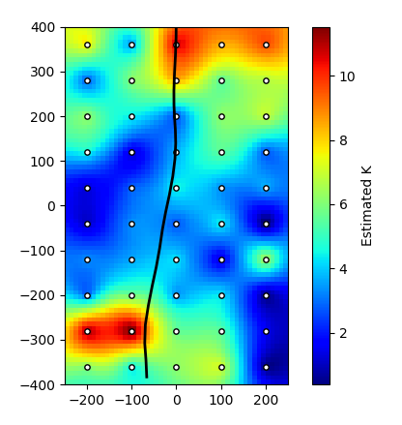
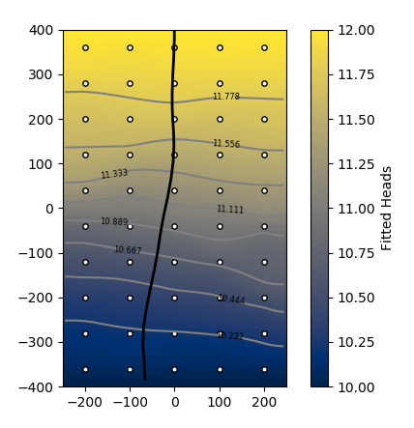
Pilot Points: Case 1
50 Pilot Points
Spherical Variogram
Variogram parameters obtained by sampling true K field
SSR = 2.2325E-04
Overfitting!
No noise added to observations

Slide 4
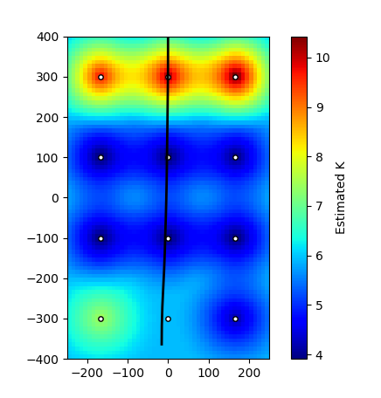
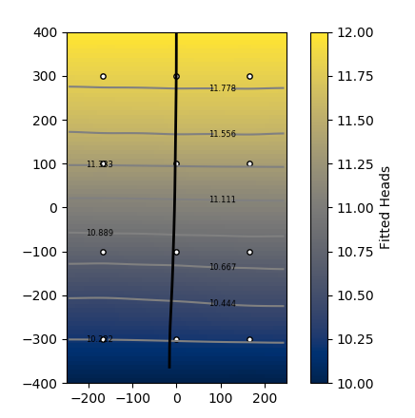
Pilot Points: Case 2
12 pilot points
Spherical Variogram
Variogram parameters obtained by sampling true K field
SSR = 5.9884E-02

Slide 5
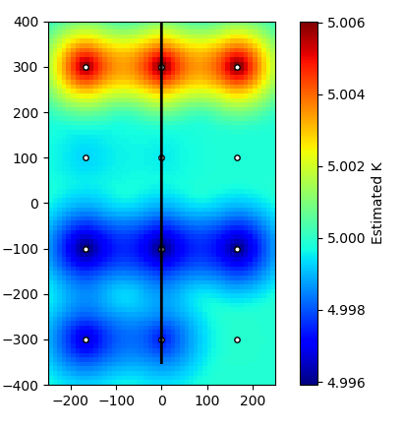
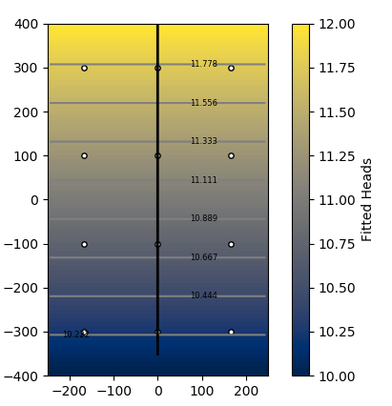
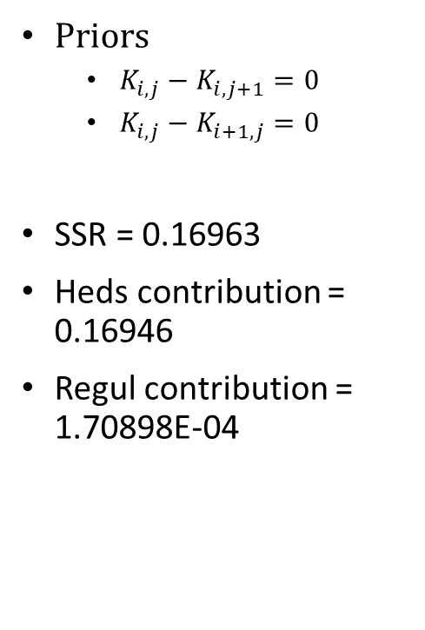
Pilot Points: Case 2 – with Tikhonov regularization
Priors
$K_{i,j}−K_{i,j+1}=0$
$K_{i,j}−K_{i+1,j}=0$
SSR = 0.16963
Heds contribution = 0.16946
Regul contribution = 1.70898E-04

Slide 6
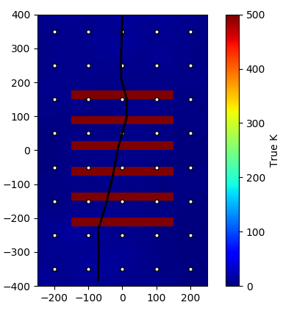
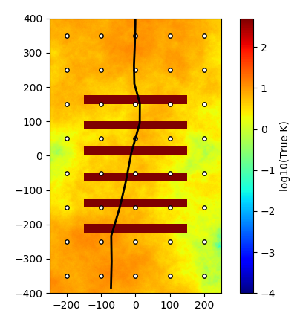
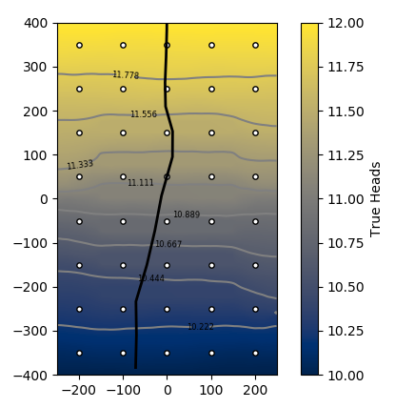
Truth: Added High K units
Same Truth model but with with 6 high K units (500 m/d) superimposed

Slide 7
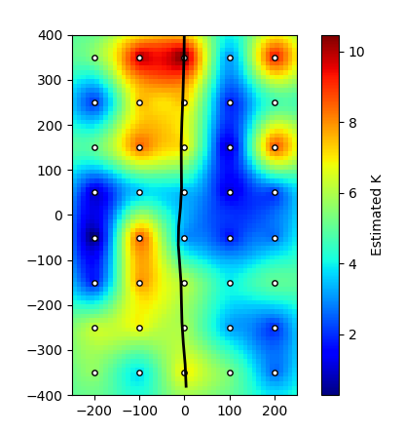
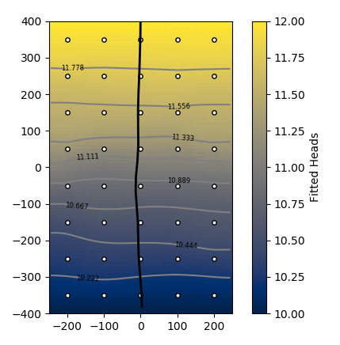
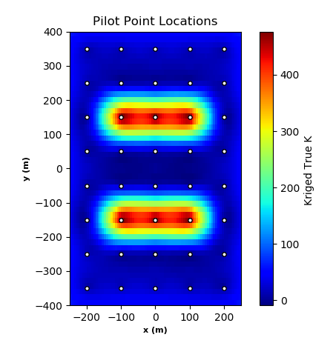
Pilot Points – No regularization
40 pilot points
No log-transformed parameters in pest
SSR = 8.0460E-04
Bad variogram model!
Poor sampling of High K units

